Slide 1
December 10, 2020

Slide 2
Remote Meeting Instructions Trevor Hebditch
This meeting is being recorded.
If you want to make a comment, please raise your hand or put your comment in the chat.
Any comment in the chat will be addressed for the recording.
If you are joining via phone, you will be muted initially. During Public Comments, your phone will be un-muted and you will be able to make a comment if desired. You may also need to press “*6” to unmute your line.
Notes:
Remember to record meeting

Slide 3
Technology Advisory Board
Agenda
Public Comments - Chair - 3 min
Approve Minutes from 10/22/20 Meeting - Chair - 2 min
Follow-Up Items (Informational):
County-Wide Website Redesign Update– Megan Hillyard– 5 min
SharePoint Document Management Update – Tony Jolley– 5 min
Working Groups Milestone Chart (Discussion/Direction) – Tony Jolley– 3 min
Working Groups Membership (Discussion) – Zach Posner – 10 min
IT Working Group Updates
GWG – IT Standards Update – (Discussion/Approval) – Mark Evans – 10 min
PWG - Budget Update – (Informational) – Cherie Root – 10 min
Webex, GRAMA, & Document Management (Informational) – Maren Slaugh & Sam Sedivec – 10 min
Data Governance Working Group Update (Informational) – Javaid Lal & Trevor Hebditch – 10 min
Nominations & Voting for 2021 TAB Chair & Vice-Chair – Chair – 5 min
Communication Items - Mayor & Council – Zach Posner & Chair – 1 min
Upcoming Meeting Schedule (Discussion/Direction) – Kristine Pepin - 1 min
Review Action Items – Kristine Pepin - 2 min
Next Meeting –2/25/21 – Chair - 1 min

Slide 4
Public Comments Chair

Slide 5
Approve Minutes Chair
Motion and Roll Call Vote

Slide 6
Review Follow – Up Items Cherie Root
TASK | RESPONSIBLE
Windows 7 Replacement | Solution Working Group
SharePoint Document Management Update | Tony Jolley
County-Wide Website Redesign | Megan Hillyard
Employee Identifier Standard Edit | Mark Evans
Policy 1400, 1400-1 – Revision to Council | Cherie Root
Separate Slide
In-Process
Complete

Slide 7
County-Wide Website Redesign Megan Hillyard

Slide 8
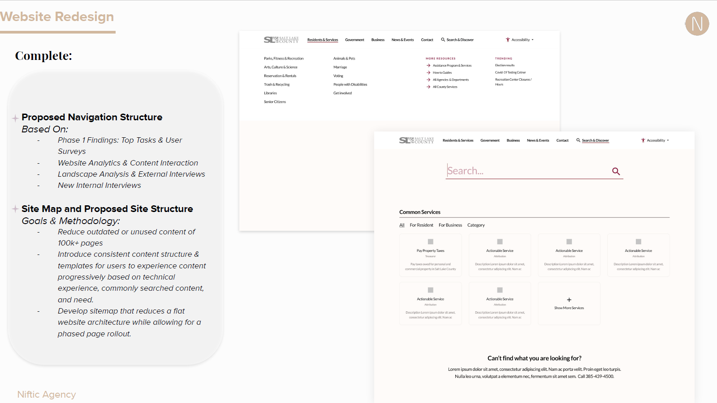

Slide 9
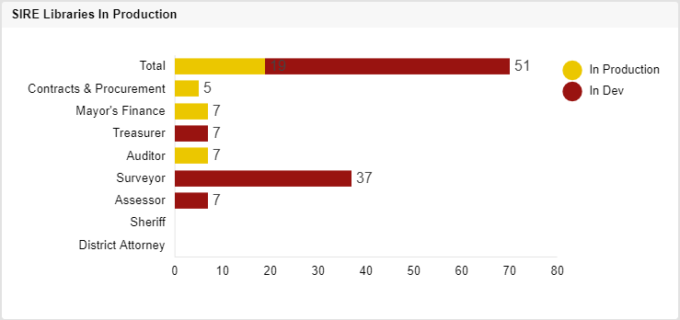
SharePoint Document Management Tony Jolley
Libraries in Production
Treasurer – Scan Tool with Batch Processing Capability Demo: 12/09/20
Surveyor – Coding for VueWorks Data Ingestion/Web Services Complete
Agency Acceptance Testing underway prior to shortly expected release into production
Assessor – Refining Agency Requirements for Customized Scan Tool
Sheriff – FileNet Data under Review for Upcoming Migration
Notes:
the chart looks like we haven’t done much since we were concentrating heavily on the Auditor for so long. However, once the Surveyor’s Office testing is complete we’ll be able to move their 37 libraries to ‘In Production’.

Slide 10
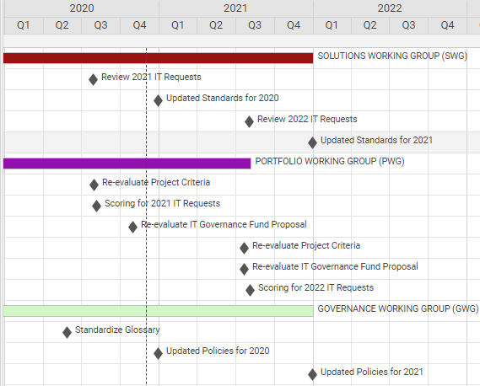
Working Groups – Milestone Chart Tony Jolley
Notes:
- We completed everything in 2020 as planned
- We plan to re-evaluate the IT Governance Fund earlier in 2021 than we did in past years.

Slide 11
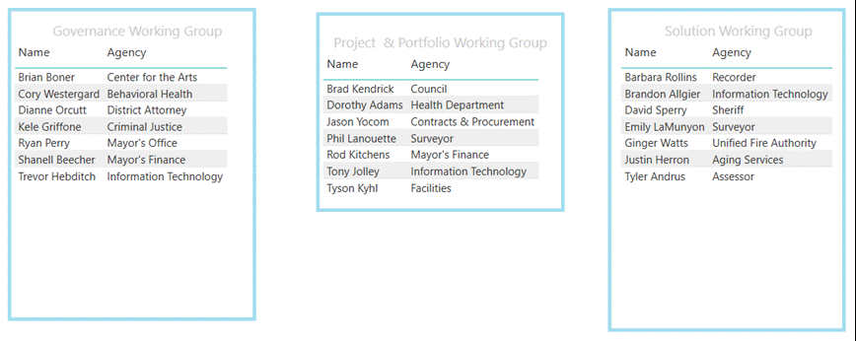
Working Groups – Current Membership Zach Posner

Slide 12
IT Working Group Updates

Slide 13
Standards Update Mark Evans
New IT Standard – Public File Uploads
New IT Standard – Public Website Accessibility Standard

Slide 14
Budget Update Cherie Root
Link to 2021 Prioritization List

Slide 15
Webex, GRAMA, & Document Management Maren Slaugh & Sam Sedivec

Slide 16
GRAMA
All content recorded through Webex tools may be considered a public record and are subject to GRAMA.
If you record a meeting save the recording for the duration outlined in your agency's retention schedule and notify participants the session is being recorded.

Slide 17
GRAMA
Follow your agency's retention schedule as you would for any other form of communication.
Be sure you are familiar with County Records Policy.

Slide 18
Document Management
Webex should NOT serve as your long-term document management repository.
Examples of appropriate document management solutions are:
SharePoint
OneDrive
network storage

Slide 19
Webex: 2-year temporary storage
SLCo’s Webex platform temporarily stores recordings saved to the cloud and Team chat, files, & links for two years from their creation date.
Note: you can individually delete material earlier as well, if necessary, to ensure you are following your agency's retention schedule.
Remember to download & save communications appropriately, if necessary.

Slide 20
Employee Communication – Sam Sedivec
Mayor’s Message
eConnect Flash

Slide 21
Data Governance Working Group Update Javaid Lal & Trevor Hebditch
Data Coordinators Training – September 14
Additional trainings will be schedule in the coming months.
Phase 1 – Application Inventory - In Progress
Inventory survey finalized - https://app.smartsheet.com/b/form/d458dcc017b3475c935adce5097634be
Inventory pilot – October/November
Surveyor
Contracts & Procurement
Animal Services

Slide 22
Data Governance Working Group Update
Phase 1 – Application Inventory - In Progress
Inventory survey finalized - https://app.smartsheet.com/b/form/d458dcc017b3475c935adce5097634be
Phase I – November 30
24 agencies were invited to participate in the survey
Addressing
Aging & Adult Services
Animal Services
Assessor
Auditor
CJAC
Contracts & Procurement
Council
Criminal Justice Services
Engineering & Flood Control
Facilities Services
Fleet Management
Health Department
Human Resources
Mayor’s Finance
Office of Data & Innovation

Slide 23
Data Governance Working Group Update
Phase 1 – Application Inventory - In Progress
Inventory survey finalized - https://app.smartsheet.com/b/form/d458dcc017b3475c935adce5097634be
Phase I – November 30
24 agencies were invited to participate in the survey
Public Works Ops
Recorder
Records Management & Archive
Regional Development
Solid Waste
Surveyor
Youth Services
ZAP Admin

Slide 24
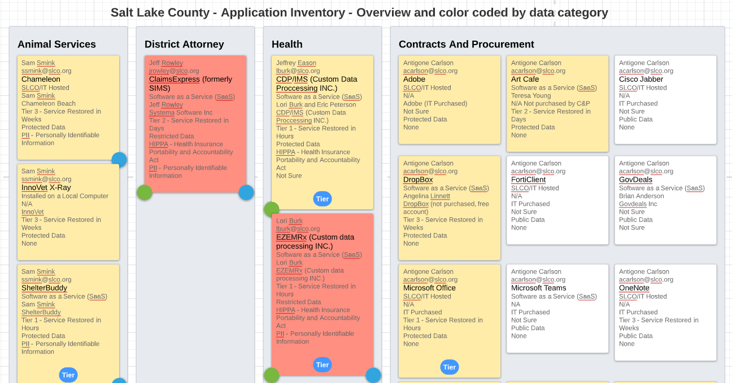
Data Governance Working Group Update

Slide 25
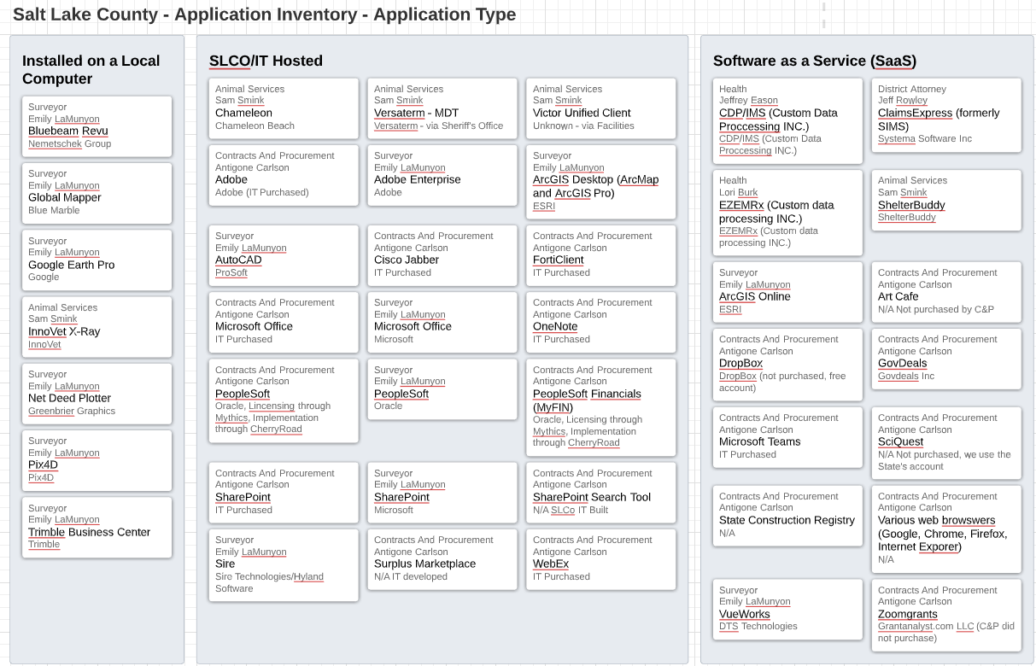
Data Governance Working Group Update

Slide 26
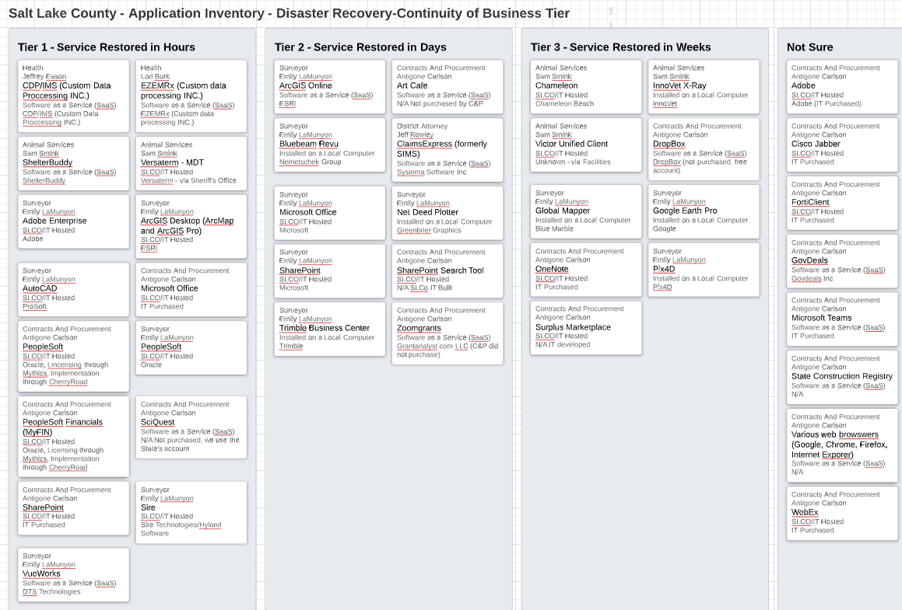
Data Governance Working Group Update

Slide 27
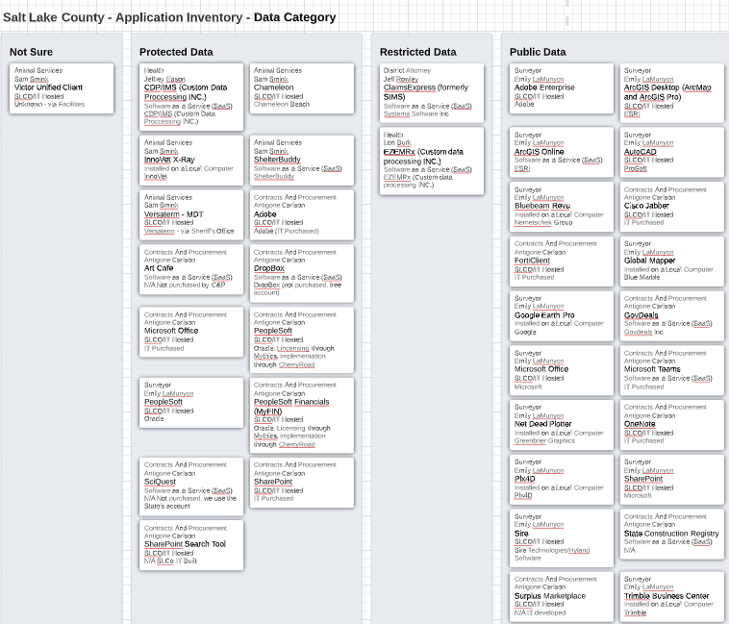
Data Governance Working Group Update

Slide 28
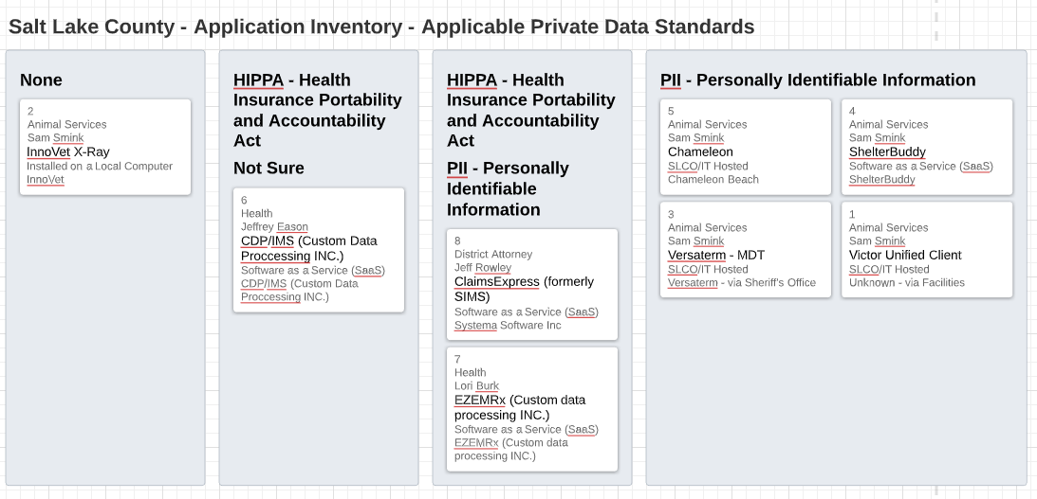
Data Governance Working Group Update

Slide 29
Please help us to complete the survey!!!

Slide 30
Nominations & Voting for 2021 TAB Chair & Vice-Chair Chair Will be done at February’s meeting. Rashelle will chair until the voting is complete. The first agenda item will be the nomination and voting.

Slide 31
Communication Items - Mayor and Council Zach Posner & Chair

Slide 32
Meeting Schedule For 2021 Kristine Pepin
9:00 – 10:30 am
February 25
April 22
June 24
August 12
August 18
October 28
December 9
Notes:
August 18 will be a final vote. This is a Wed to not conflict with GIS Steering Committee.

Slide 33
Review Action Items Kristine Pepin

Slide 34
Next Meeting – 2/25/21
Thank - You
Motion and Vote to Adjourn

Slide 36
Technology Advisory Board
Slide Title

Slide 37
Technology Advisory Board
Slide Title
Numbered List
Numbered List
Numbered List
Numbered List
Numbered List
Numbered List

Slide 39
Webex, GRAMA & Document Management Sam Sedivec
Sam wants the following invited: (to help answer questions)
Phil Martinez
Corey Hess
Mark Miller
Jerome Battle
Maren Slaugh
https://www.slcounty.org/uploadedFiles/depot/admin/fIS/Webex-GRAMA-Doc.Management.pdf

Slide 40
TO-DO List

Slide 41
Technology Advisory Board
Agenda
Public Comments - Chair - 3 min (9:00 – 9:03)
Approve Minutes from 10/22/20 Meeting - Chair - 2 min (9:03 – 9:05)
Follow-Up Items (Informational):
County-Wide Website Redesign Update– Megan Hillyard– 5 min (9:05 – 9:10)
SharePoint Document Management Update – Tony Jolley– 5 min (9:10 – 9:15)
Working Groups Milestone Chart (Discussion/Direction) – Tony Jolley– 3 min (9:15 – 9:18)
Working Groups Membership (Discussion) – Zach Posner – 10 min (9:18 – 9:28)
IT Working Group Updates
GWG – IT Standards Update – (Discussion/Approval) – Mark Evans – 10 min (9:28 – 9:38)
PWG - Budget Update – (Informational) – Cherie Root – 10 min (9:38 – 9:48)
Webex, GRAMA, & Document Management (Informational) – Maren Slaugh & Sam Sedivec – 10 min (9:48 – 9:58)
Data Governance Working Group Update (Informational) – Javaid Lal & Trevor Hebditch– 10 min (9:58-10:08)
Nominations & Voting for 2021 TAB Chair & Vice-Chair – Chair – 5 min (10:08 – 10:13)
Communication Items - Mayor & Council – Zach Posner & Chair – 1 min (10:13 – 10:14)
Upcoming Meeting Schedule (Discussion/Direction) – Kristine Pepin - 1 min (10:14 – 10:15)
Review Action Items – Kristine Pepin - 2 min (10:15 – 10:17)
Next Meeting –2/25/21 – Chair - 1 min (10:17 – 10:18)

