Slide 1
Administrator Training

Slide 2
Table of Contents
Shopping on Amazon Business
Business Account Navigation
    Billing & Shipping
    Shared Settings
    Business Order Information
    Budget Management (BPO)
    Delivery Preferences
Members
    User Roles & Permissions
    Adding Users to the Account
    Removing a User from the Account
    Groups
    Buying Policies
      Guided Buying
      Approvals
Amazon Business Analytics
Your Orders
Business Customer Support

Slide 3
Shopping on Amazon Business

Slide 4
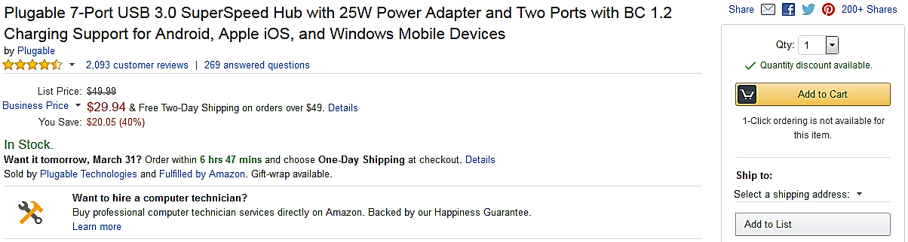



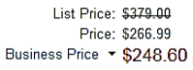
Amazon Business Benefits
Business Pricing & Quantity Discounts
Business pricing and quantity discounts are only available to registered business account customers on Amazon. Click to learn more.
Business Prime Shipping
Once Business Prime Shipping has been purchased, it provides Free Two-Day Shipping on eligible items for all users in the business account. There are multiple pricing tiers to meet the needs of businesses of all sizes. Click to learn more.
Buying Policies
Customize Amazon Business to your organization’s buying standards and procedures. Features include approval workflows, negotiated pricing, and preferred suppliers and preferred products. Is this for ALL sub departments? Can they each come up with their own?
Business-Only Selection
Business-only selection refers to items and offers that are only available for purchase by Amazon Business customers.
Amazon Business Analytics
Use Amazon Business Analytics to view data about your orders, create and filter reports based on your business needs, and view both charts and tables. Click to learn more.

Slide 5

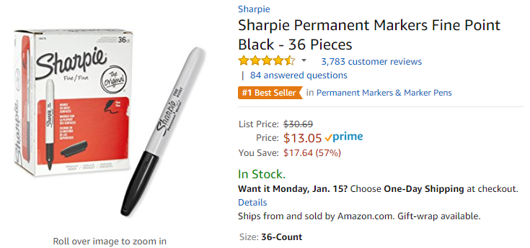
Take Advantage of Amazon Prime Shipping Benefits
An easy way to ensure that your products arrive on time and as expected, is to order products fulfilled directly from Amazon. All products clearly mark who the seller is on the product detail page.
Prime Eligibility – Fulfilled by Amazon
Prime eligible items are fulfilled by Amazon. We recommend searching for prime eligible items.
What’s not Included?
Business Prime Shipping does not include additional Prime benefits such as Amazon Fresh, Pantry, Video, or Music. AUDIO BOOKS?

Slide 6
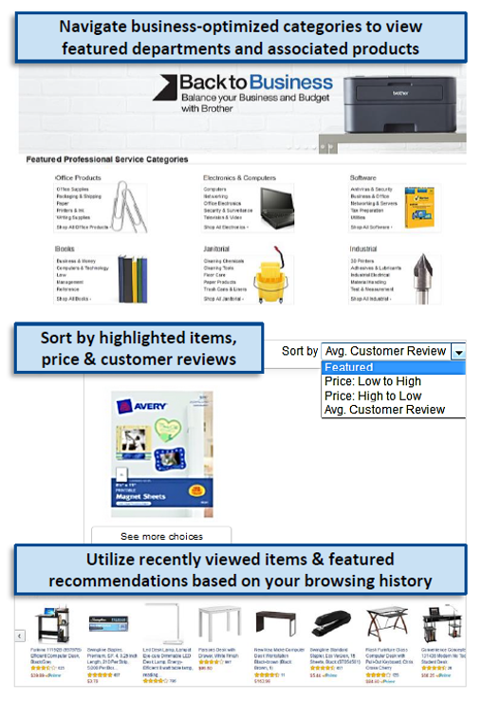
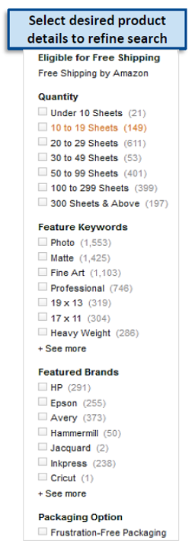
Search & Browse Optimization
Optimizing search functions in Amazon Business allows you to find the best products to meet your needs and compare prices to find the best value
Amazon is the “everything store.” With such a large selection, we do our best to make it easy for you and your end users to find what you’re looking for.
Recommended filters:
  Business Sellers
  Prime Eligible
  Brand
  Average Customer Review/Rating
  Diversity Credentials

Slide 7
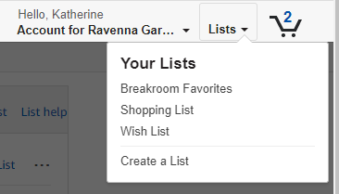
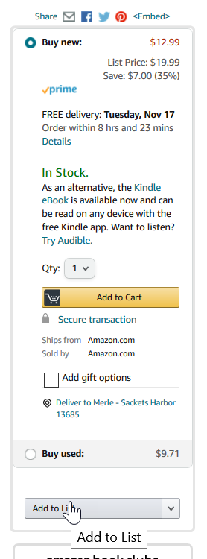
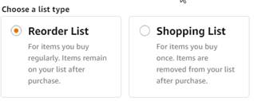
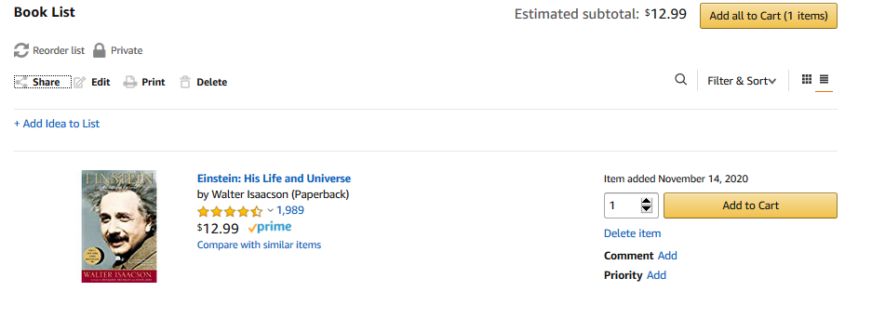
Reorder & Shopping Lists
How do lists work on Amazon Business?
Lists make it easy to keep track of the things you need and are easy to share with others. Any User on Amazon Business can create a shopping list
Choose between multiple list types depending on if you want the items to remain on a list after they are ordered
Instead of adding items to the cart, users will add items to a list to share with other users.

Slide 8
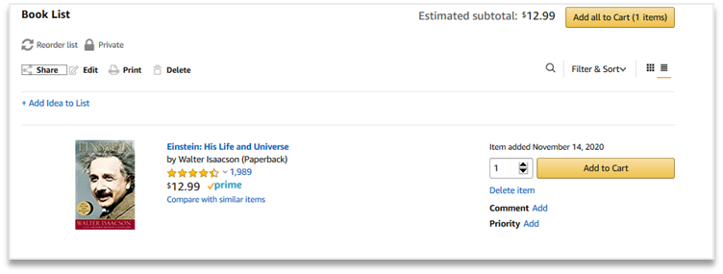
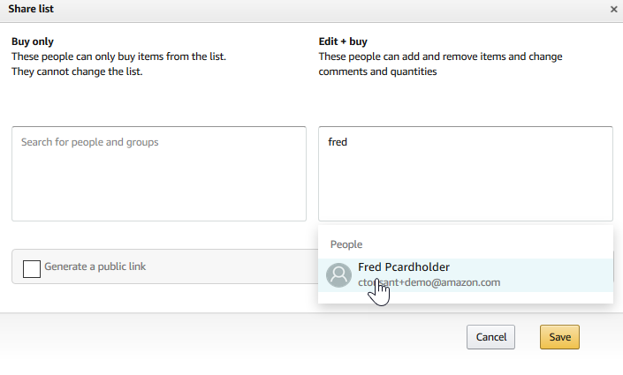
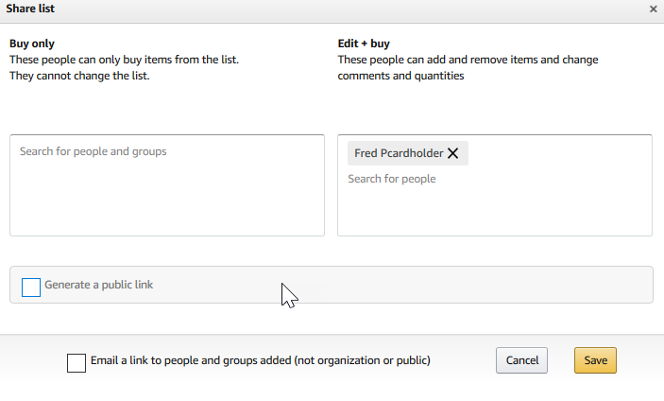
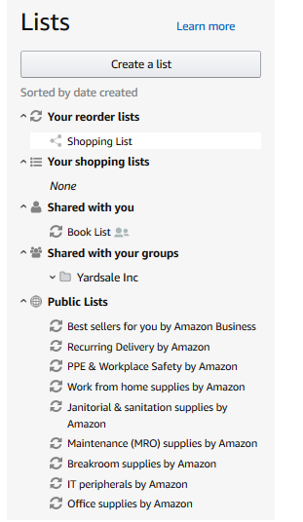
Reorder & Shopping Lists
Sharing the list
Click “Share” to choose a user with whom you would like to share the list.
Choose whether the user will be able to edit the list and enter then enter a name in the box underneath.
Once you select the name, choose whether you want the user to receive an email notifying the user a list has been shared.
Click save and now the list appears in the selected user’s Shared with you within Lists.

Slide 9
Business Account Navigation

Slide 10
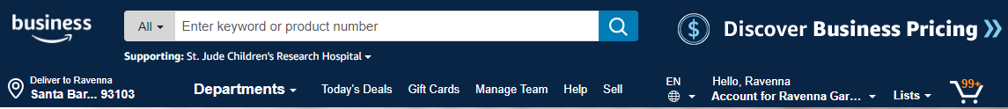
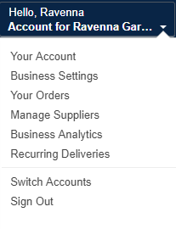
Business Account Navigation
Page | Functionality
Your Account | Standard Amazon account information
Business Settings | Business Management pages. Add users, set up groups, configure buying policies, etc.
Approve Orders | If workflow approvals are enabled, approvers can view and take action on pending orders
Your Orders | View and track your orders. Administrations can view orders others have placed on behalf of the organization
Manage Suppliers | Easily find suppliers on Amazon Business and add them to your list of Saved Suppliers. Learn more.
Business Analytics | Create and filter custom reports based on your business needs to view your organization’s orders
Recurring Deliveries | Have essential items delivered automatically, based on a schedule you choose. Learn More.

Slide 11
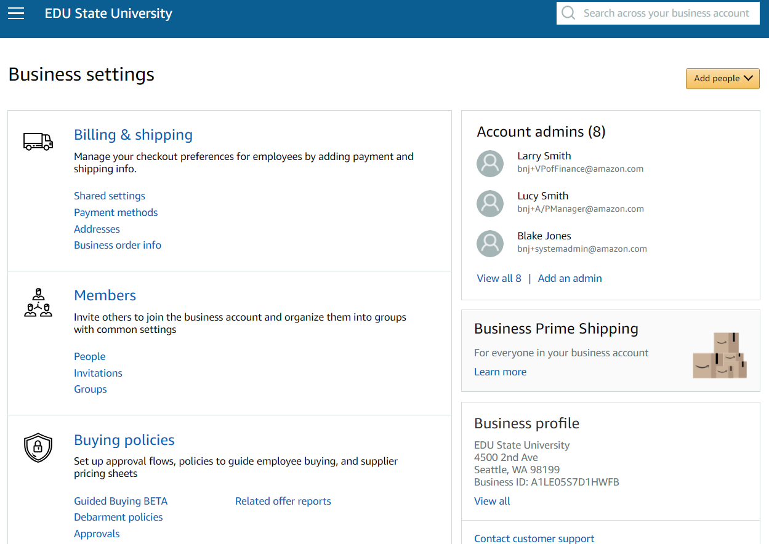
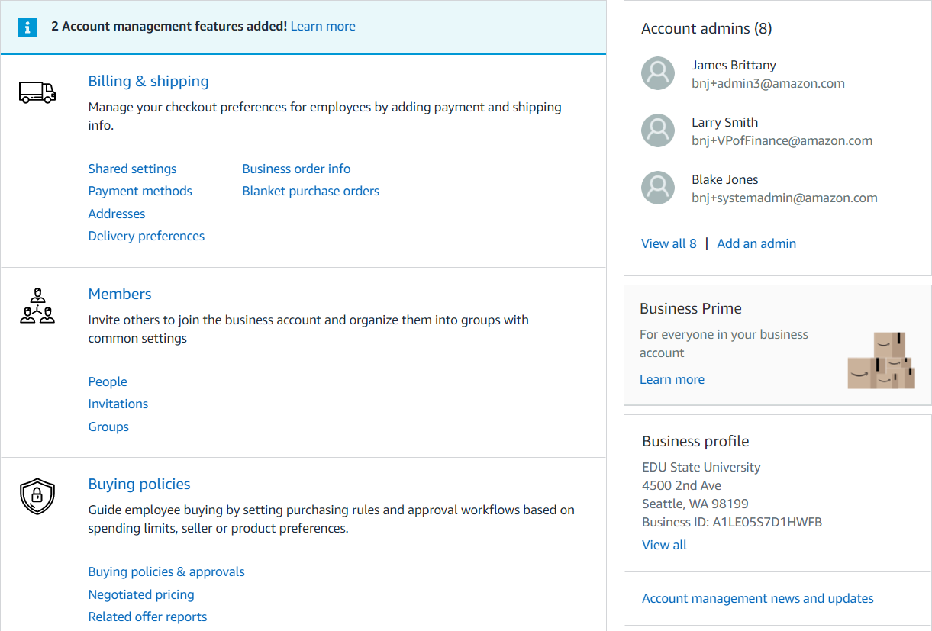
Business Settings
Group Administrators have the ability to add and remove users, and designate a backup approver in the event they are out of the office and unable to approve orders. All of these changes are made under “Business Settings.”

Slide 12
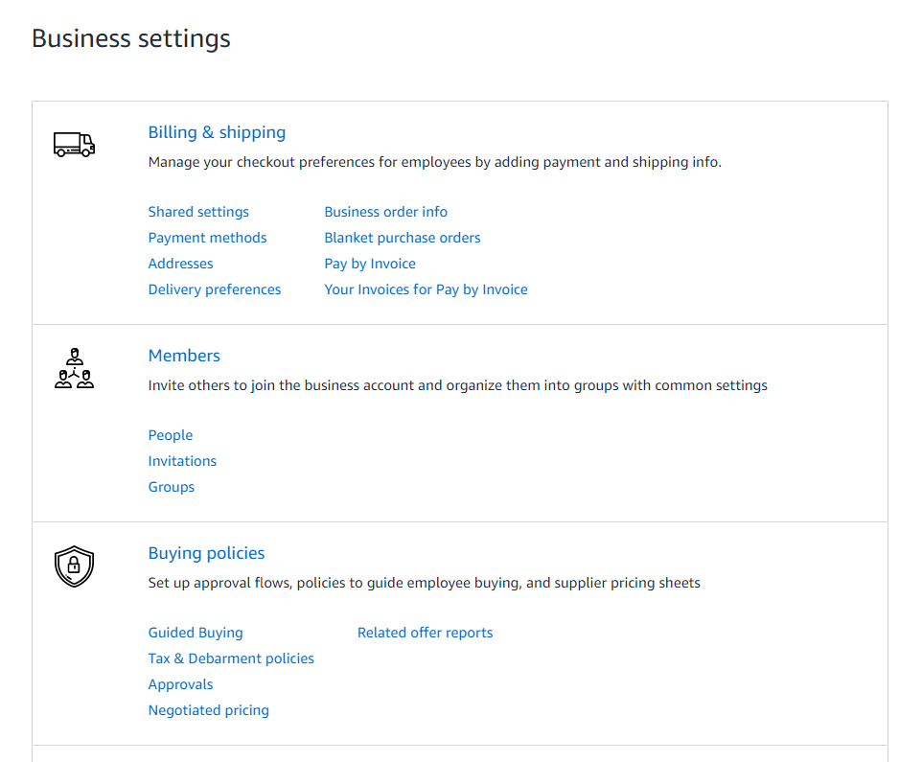
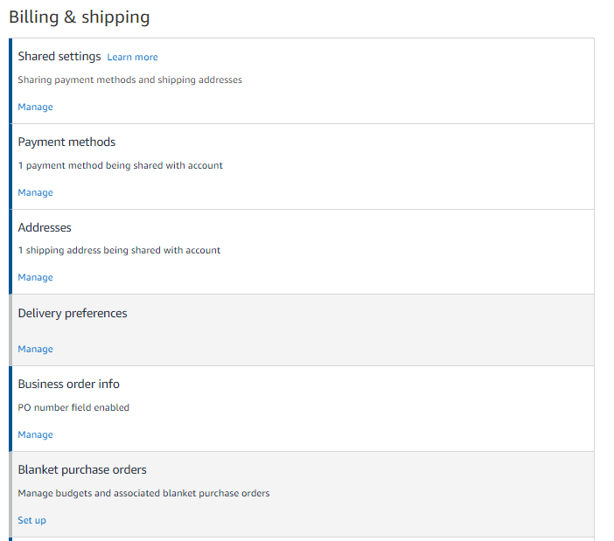
Billing & Shipping
Manage your checkout preferences for your users by adding payment, shipping, and order information like PO numbers.
Enabling Shared Payment methods and/or Address sharing lets administrators pre-configure the shipping addresses and/or payment methods requisitioners have access to during checkout.
IF shared settings are configured for an account or group, click into the Payment Methods & Shipping Addresses section to designate which addresses & payment options are available. If utilizing individual pay settings, there is no need to configure these sections.
Configure additional Business order information fields that your users will complete at checkout such as PO number, Cost Center, and GL Codes to ensure your orders are tracked in accordance with your business’s needs.

Slide 13
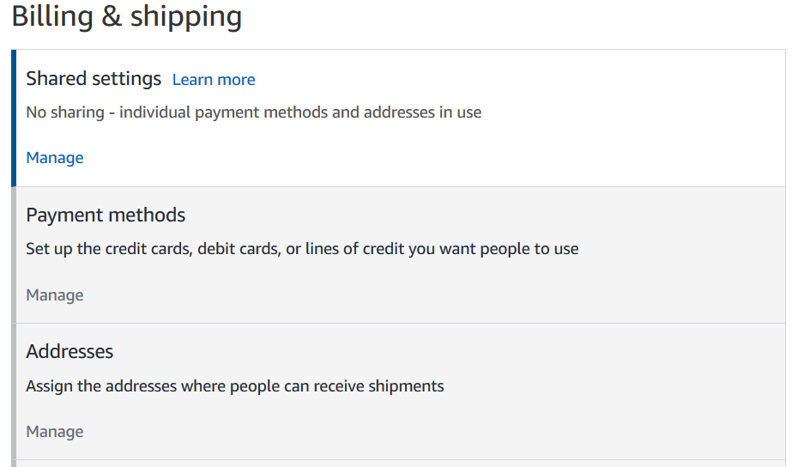
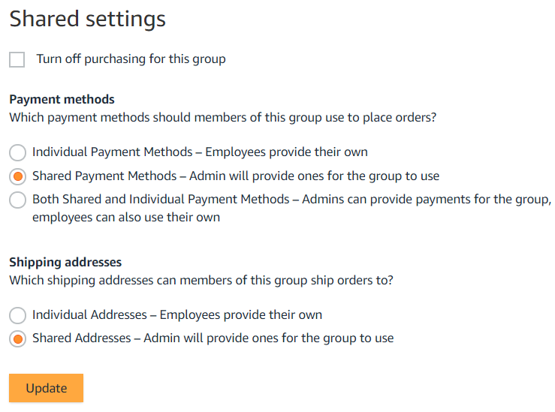
Shared Settings
Administrators can configure at the group level whether Payment Methods and Shipping Addresses will be shared and managed by an Administrator or Individual and managed by the end user.
Considerations
Individual:
End users enter and store addresses during initial setup or checkout
Administrators use analytics reports to audit shipping locations
Shared:
  Administrators enter addresses for each group manually or with an upload spreadsheet
  End users can only ship to addresses shared with their group by an Administrator
  End users will have an option to add their name in the “deliver to” field
Shared and Individual (Payment Only):
Administrators can provide payment and end users can also use their own in the same group

Slide 14
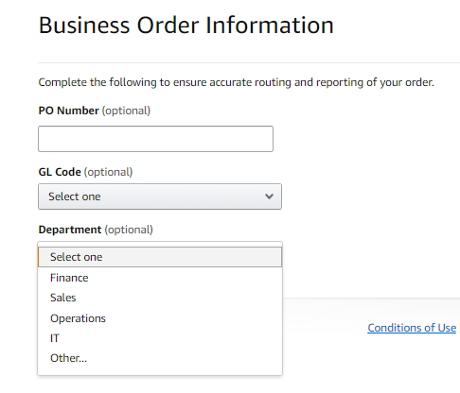
Business Order Information
Track and manage orders by setting up custom fields that display on order documentation and reports
Business Order Information needs to be activated at the account level by an account Admin.
All information entered will appear in Order History Reports in the Business Analytics tool.
Each field can be required or optional.
There are up to 100 options that can be pre-configured in a drop down style menu.
[SCREENSHOT FROM
CUSTOMER ACCOUNT]
Available Fields
GL Code | Cost Center
Project Code | Location
Department | *Custom named field*
Purchase Order (PO)

Slide 15
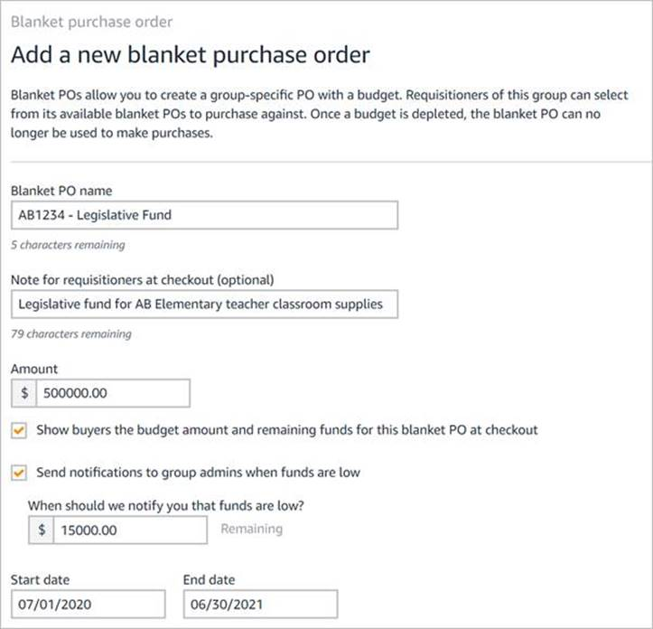
Blanket Purchase Order (BPO) for Budget Management
Monitor and manage budget usage in real time
Configure budgets (Blanket POs) and assign them at the group level to track spending and help prevent budget overspending.
Budgets can be created at the group level by account or group level admins by visiting: Business Settings > Members > Groups > [Group Name] > Billing & shipping > Blanket Purchase Orders
Required fields are Name, Amount, Start/End Date
Admin’s are encouraged to add a Note for clarity to end users making purchases.
Create a low fund notification for monitoring completion of budget by BPO
PO numbers are a required field in Business Order Information
The “Name” field is not editable after the creation of a BPO by an administrator

Slide 16
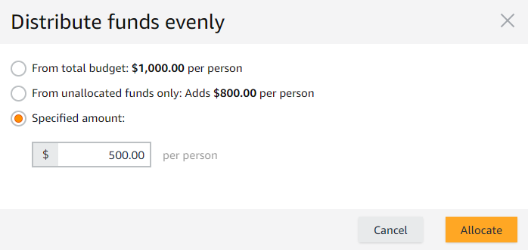
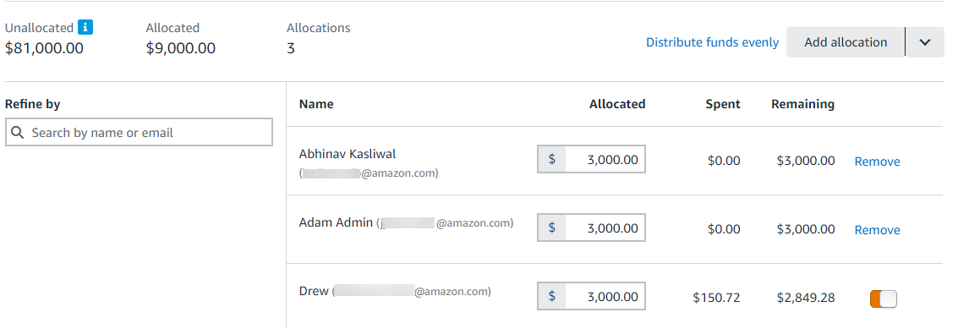
Blanket Purchase Order (BPO) for Budget Management
Allocate funds to individual users within your Amazon Business account
BPO funds can be allocated at an individual level and assigned to specific users.
Users are required to be active on your Amazon Business account and within the group where BPO is applied.
Allocations can be configured manually at an individual level or distributed evenly from the total budget, unallocated funds, or a specified amount.
Unallocated funds will be available for the remaining group members (users who don’t get any fund allocation yet). To prevent users from spending unallocated funds, give $0 allocation to the users or keep the unallocated funds at $0.

Slide 17
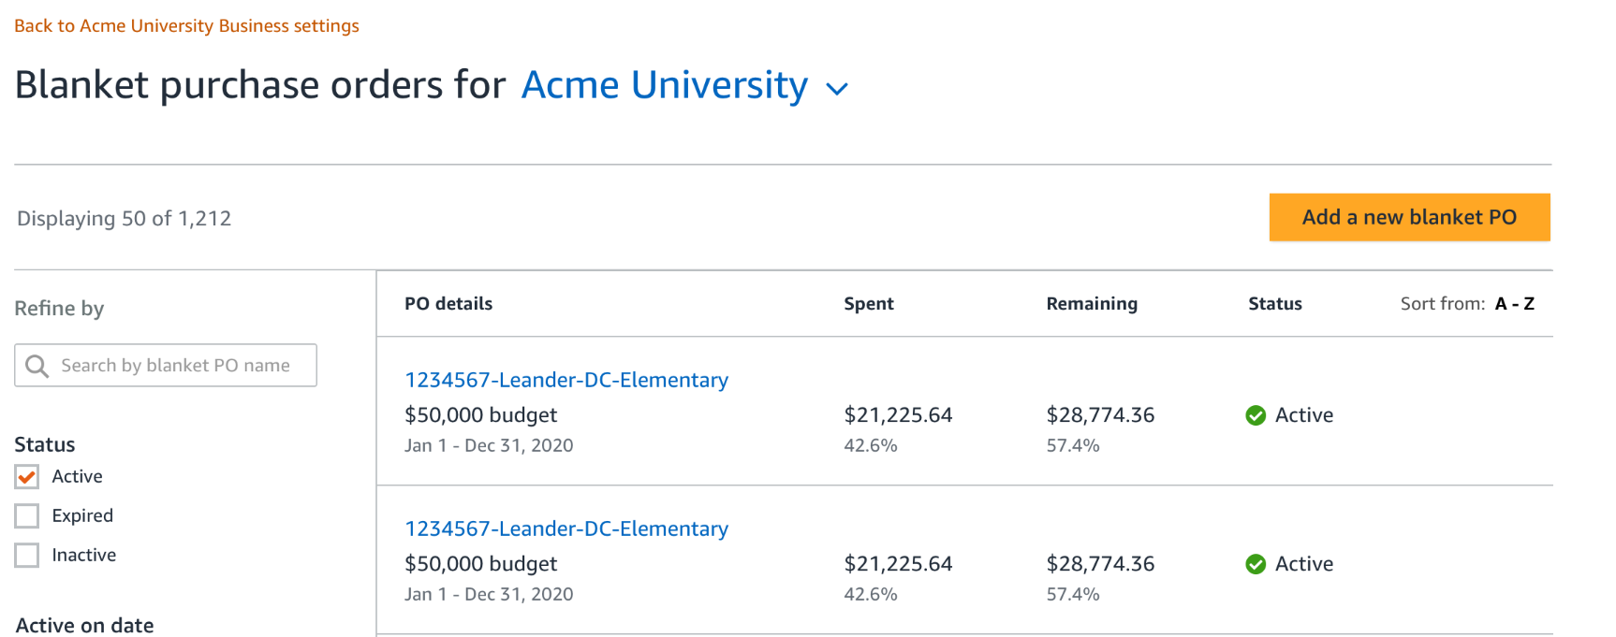
Blanket Purchase Order (BPO) for Budget Management
Create budget lines to track spending in real time, and prevent budget overspending
Group admins can manage all BPOs and access an individual BPOs usage with links embedded in the BPO management experience

Slide 18
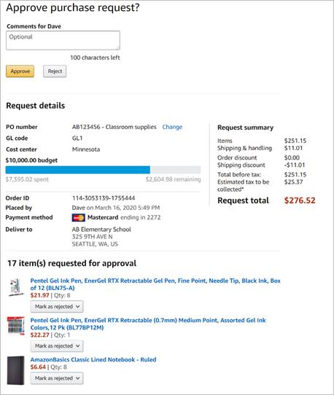
Blanket Purchase Order (BPO) for Budget Management
Add order approvals for increased budget management controls
For orders qualified for both budgeting (by using Blanket PO) and Approvals (by using Approval workflow policies), Approvers will be able to monitor budget status during approval process as orders are being placed.
If a requisitioner submits an order for approval using the incorrect Blanket PO, during the Approval process the Approver can change to a different Blanket PO that is active in their ordering Group.
Approvers will see the status of the Blanket PO Budget on the approval screen.

Slide 19
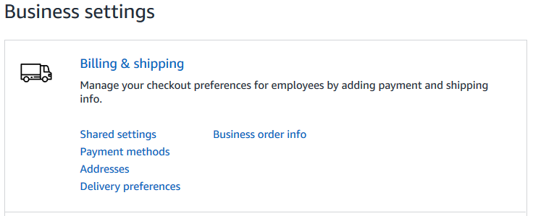
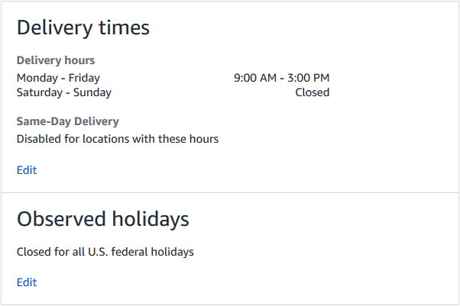
Delivery Preferences
Administrators can configure shared default delivery settings for all addresses on their account. Settings such as Delivery Hours, Closed Days of the Week, Same Day Delivery opt-in for commercial addresses, and Federal Holidays.
Delivery Preferences
LEG Admins can set Delivery Hours by day, and set open or closed weekend days
Admins can also set 1 weekday as closed for their account
Same-Day delivery can be enabled/disabled for an account
LEG Admins can also set which U.S. Federal Holidays their account is closed/open.

Slide 20
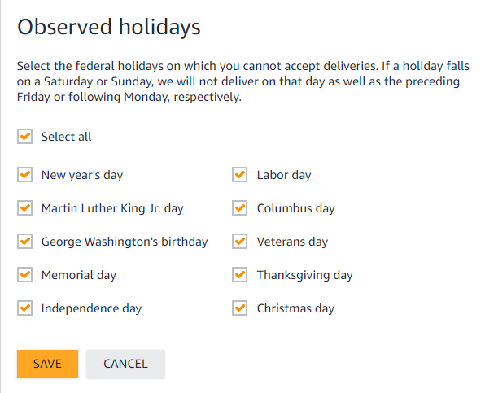
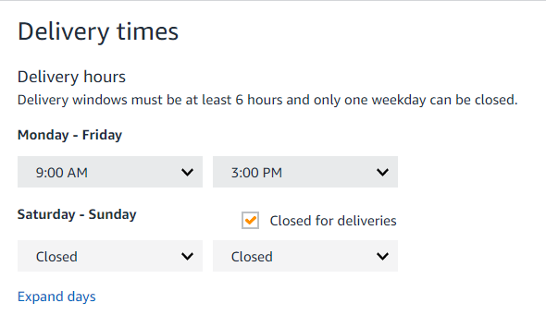
Delivery Preferences
Customize delivery days and times to ensure your packages are delivered when someone is available to receive them
Settings can be adjusted under Business Settings>Billing & delivery preferences by root level admins
Preferences entered here will be the default for all shipping addresses on the account, however they can be adjusted by address by requisitioners as needed
Changes made here will only impact items shipped from Amazon

Slide 21
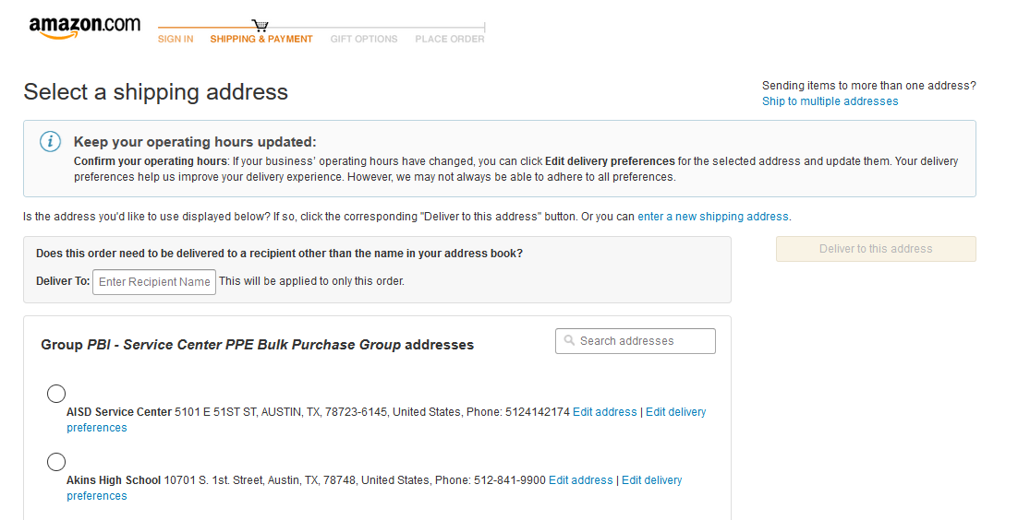

Ship to Multiple Addresses
At checkout, select ‘Ship to Multiple Addresses’
A few address lines will auto populate
  Select a different address for each line
  Select Update to generate more options
3. Select the quantities and addresses at each line item
  Select a different address for each line
  Select Update to generate more options
Group 1, 123 Main Street, Seattle,WA
4. Confirm Quantity per address and update each line’s desired address
Group 2, 566 S. Main Street, Seattle,WA
5. Select Continue and review each checkout step as normal

Slide 22
Members

Slide 23
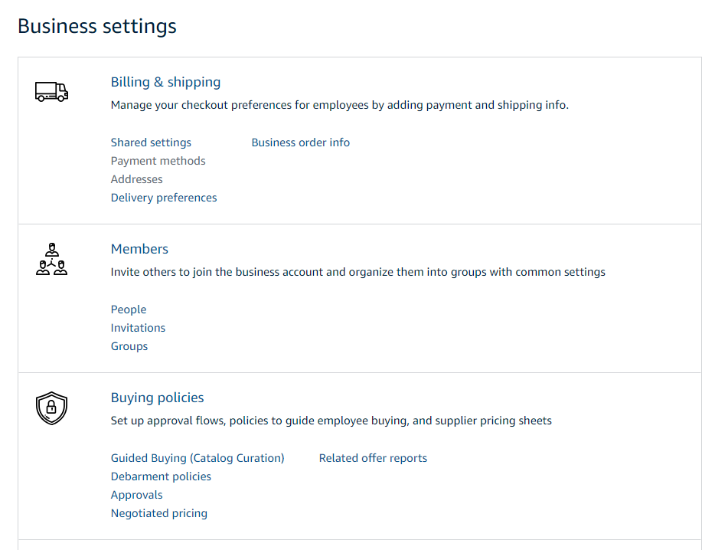
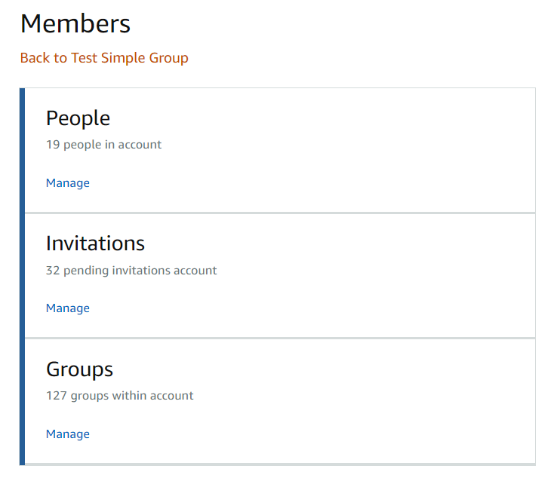
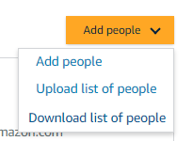
Members
Invite others to join the business account and organize them into groups with common settings
The People section of your account enables you to manage all active users on the business account. You can add and remove users, edit user roles, and download a complete list of account users from this section of your account.
The Invitations section tracks all pending and expired invitations to users. Once a user has accepted their invitation, that person will move to the People section.
To help keep your users organized, people can be added to specific Groups. Many settings such as approvals, shared payment methods, and catalog curation messages can be configured at the group level

Slide 24
User Roles & Permissions
Each user can have multiple roles -- administrator or requisitioner, or both. Permissions can be assigned when an administrator invites a user to the business. Administrators can change user permissions at any time.
Assign administrator permissions on a per-group basis. One administrator can manage multiple groups. Group level administrators only have admin authority over the group(s) they are assigned.
Role | Permissions & Functionality | Visibility
Administrator | Manage business settings & business features Invite people to join the business account Remove users from the business account Assign a role to a user Set up approval workflows and spending limits Configure shared payment methods and shipping addresses Add certifications such as tax exemptions to the business account | Administrators can view orders and order history for all purchases in their group(s) on behalf of the business. Last 4 digits of any payment methods used by Requisitioners Billing & Ship to addresses All Amazon Business Analytics fields for orders placed by users in their group(s)
Requisitioner | Place orders on behalf of the organization Add payment methods and shipping addresses at checkout *if individual pay is configured Utilize Business Analytics for their own purchases Can be configured as an Approver | Order history for all orders that they placed for their organization with their business user account Shipping addresses & payment methods (last 4 digits visible), as established by the administrator

Slide 25
Accessing the Account through Single Sign On
Accessing the Amazon Business account is simple for end users when Amazon is integrated with your organization’s IDP
How do end users sign in?
To access the centralized account, use the link provided to access Amazon Business. This will automatically log you into the appropriate account.
Depending on how users have used their work email on Amazon in the past, they may need to take action to separate or migrate an existing account.
  For those who have not used their work email in the past, they will be immediately authenticated into the central account.
  For those who do need to take action to separate out their existing account, this is a one time process. They will be authenticated automatically each subsequent time.
Link to Join through SSO:
<inert link>
or Screenshot

Slide 26
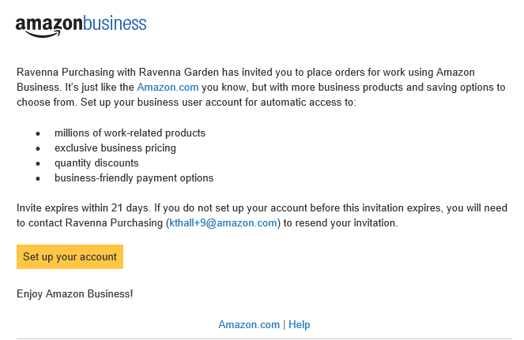
Inviting Users to Amazon Business
Administrators can add users to the account one by one or all at once by uploading a spreadsheet
How do Invitations Work?
When a user is added to the business account, an invitation to join is immediately emailed.
Invitations are tied to an end users email address. The recipient cannot change the email address they use to register for the account.
End users must take action after being invited to an account in order to become an active user.
User permissions are assigned when a user is invited.
Account invitations are valid for 90 days from send date. After 90 days, they will expire and need to be resent
your account admin email@company.com)

Slide 27
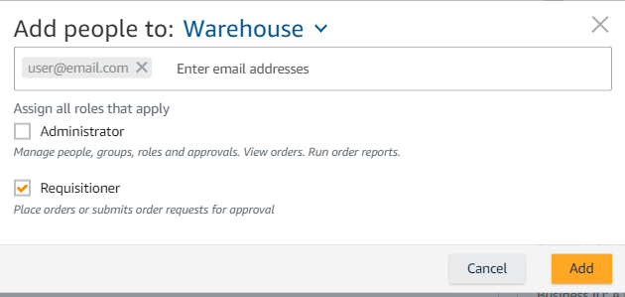
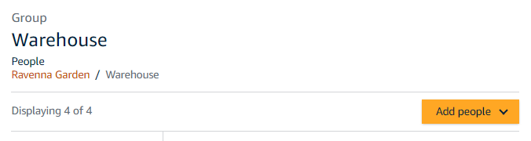
Add a New User
Administrators can add users to the account one by one or in bulk using a spreadsheet
Add Users from Business Settings
Under the “Add people” button at the account or group level, select “Add people” again. Enter the user’s email address and select the appropriate user permissions. You can select one role or both. Up to 12 people can be invited in this window at once.
Add Users from any Group
If you navigate directly to a subgroup within an account, you can also add users. Once at the group, click Members>People>Add People

Slide 28
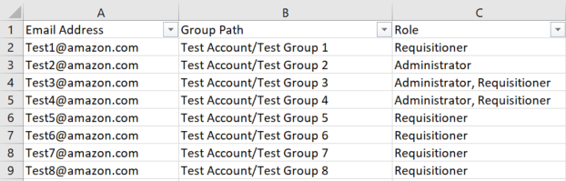
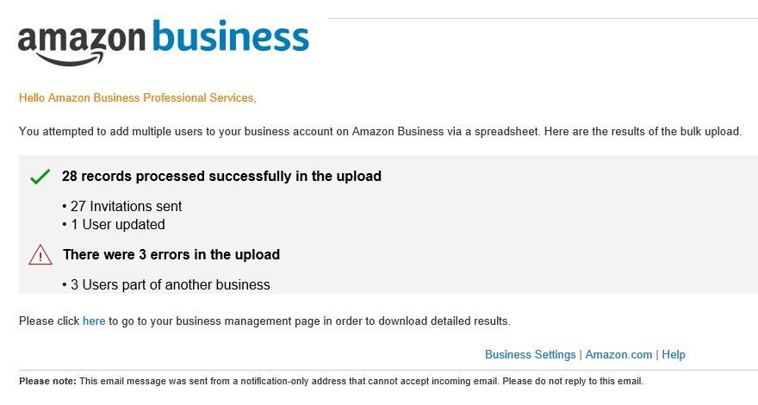
Add Multiple Users
Administrators can add users to the account one by one or in bulk using a spreadsheet
Bulk User Invites
Under the “Add people” button at the account level, select “Upload list of people”. Using the provided template, invite multiple users to separate groups and designate their roles.
Bulk Upload Results
After a spreadsheet has been uploaded, the admin will receive an automated report indicating any emails that were not able to be processed or invited. These failed invites usually indicate that an end user has an existing Amazon Business account.

Slide 29
Add Multiple Users with Account Authority
Account Authority enables administrators to “claim” their company domain and simplify the user registration process by automatically creating accounts on behalf of end users
Bulk User Invites
Under the “Add people” button at the account level, select “Upload list of people”. Using the provided template, invite multiple users to separate groups and designate their roles. First and last name columns must be included for an account to be created for each end users.
User Status
Active | User account has been created
Pending | User is a member of an existing consumer account. They must either “split” or “merge” this account over
Pending Merge | User is a part of an existing business account
Merge Deferred | User has indicated they do not want to merge their existing business account to the master at this time
Bulk Upload Results
After a spreadsheet has been uploaded, the admin will receive an automated report indicating any emails that were not able to be processed or invited. Note, the only users that cannot be invited are those a part of existing multi-user business accounts.

Slide 30
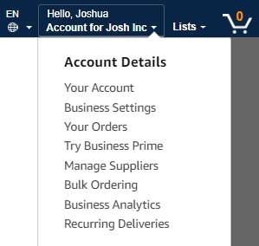
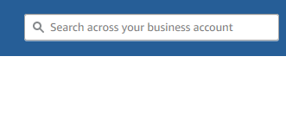
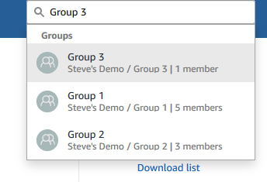
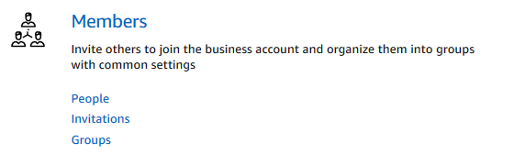
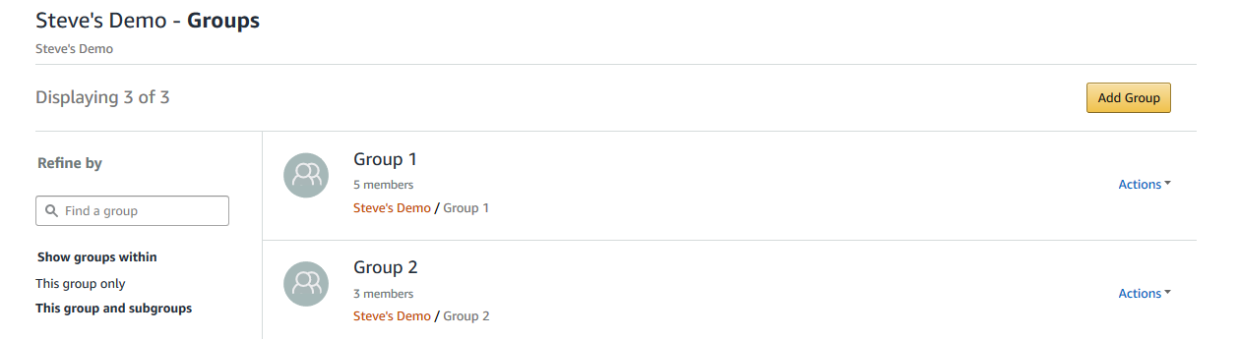
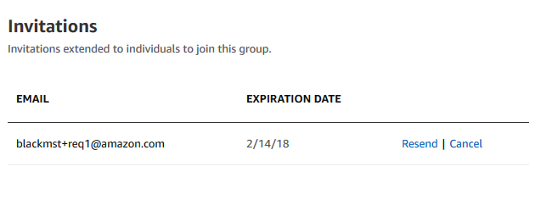

Resend an Invite to a Pending User
Navigate to Business Settings
Input group name in search bar and select correct group
OR
Select Groups from the Members area of Business Settings to display
Select desired group to view Group Business Settings page
Once you are in the correct group, from within the “Members” section of your settings page, select Invitations
Select “Actions” and Resend for the invited user**

Slide 31
Download List of Users and Pending Invitations
Invitation Status | Definition
“Expired” | The invitation has expired and an administrator must re-send a new invitation for the user to join (see this slide)
“Pending” | User is a member of an existing consumer account, and they must take action via the link sent to them in an invitation. The user will be required to “Convert” their account or “Split” personal account history (see FAQ)
“Pending Merge”** | User is a part of an existing business account, and they must take action via the link sent to them. This process will de-register their existing Business Account and allow them to merge into the official business account, maintaining purchase history.
“Merge Deferred”** | User has indicated they do not want to merge their existing business account into the official account.
Blank (the cell is empty) | The user is ACTIVE and a member of the indicated group(s). For automatically created accounts, the user may not have set their password yet. In this case, the user must follow password reset instructions (see FAQ).
Invitation URL can be sent directly to invitee to activate their login

Slide 32
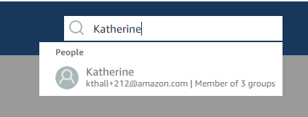
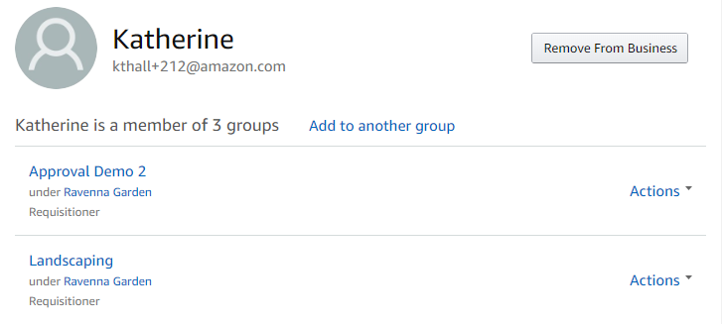
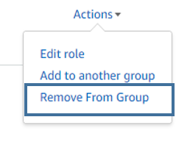
Remove a User
To remove a user, navigate to the User’s profile page on Amazon Business. You can locate a user through the search bar or the “people” section of the account or a subgroup.
email@Amazon.com
email@Amazon.com
Once you have found the user, you can either remove them from a specific group or from the business account as a whole.
An extra confirmation is required to remove a user completely from the Business account. Once a user is removed, they will need to accept a new invitation to regain access to the account at a later time.

Slide 33
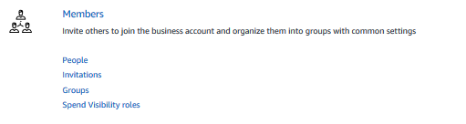


Move and Remove Users in Bulk
To move or remove users in bulk, navigate to the ‘People’ section on the root level of the account and click on ‘Manage Via Spreadsheet’. You can then upload the spreadsheet template to manage users in bulk. Be sure to reference the ‘Spreadsheet Guide’ for guidance on how to format the spreadsheet template for various functionalities.

Slide 34



Groups
You can use groups to organize users and purchase settings based on your business needs. Many customers create groups based on business units, departments, locations, or payment method.
Groups may have one or more administrators, and one or more requisitioners. You can have an administrator for the business who manages all individual groups, or an individual administrator can be created for each group.
To create a new group:
Click the button from the top right of the Groups page.
Enter the desired group name
Select shared settings for the group
Click again to complete
Group Level Features:
Shared payment methods and shipping addresses
Approval workflows
Guided Buying Policies

Slide 35



Determine Who is in Your Group(s)
Download a user list
Navigate to “Business Settings”
Select “Add people”
Select “Download list of people”. This action will trigger an email from no-reply@amzon.com sent to your inbox titled “YOUR NAME, your customer list is ready to download”
Select the hyperlink in the email to download an excel file

Slide 36
Buying Policies

Slide 37


Buying Policies
Set up approval workflows, restrict product categories, and direct end users to your organization’s preferred products to ensure purchasing compliance at your organization
The Guided Buying tool allows administrators to prefer and restrict different products and product categories to encourage compliant purchasing behavior
Configuring Approvals ensures that Amazon Business orders get the proper level of oversight whether approvals are required for all order or only specific purchasing thresholds
Leverage the pricing you have already negotiated with key suppliers with the Negotiated Pricing tool which allows you to bring contracted pricing into the Amazon Marketplace
Related Offer Reports capture alternate purchasing offers each time an end users makes a qualifying purchase

Slide 38


Guided Buying
Guided Buying enables you to select specific products and suppliers as company preferred, directing each user’s purchase selections through display messaging within the shopping and checkout experience.
Search for and discover suppliers through the list of diversity credentials, as well as by entering a known supplier’s name directly, then save them as a preferred supplier.
Restricted policies designate UNSPSC based product categories as company non-compliant. Create custom text, alerting users that the item may not comply with your company’s purchasing policies. Approval workflows can also be configured based off of these policies.
EXCLUSIVE

Slide 39



Company Restricted
Administrators can customize messaging to let end users know IF and WHEN they can purchase certain UNSPSC based categories on Amazon Business
Restriction Best Practice:
If you are unsure of the specific UNSPSC you want to restrict, use the tool to search the product name for suggested codes and sample product images.
Be aware, restricting a category does not prevent a purchase but adds a warning.

Slide 40



Company Blocked
Hard blocking product categories prevents an end user form adding these product to their cart. The add to cart option will appear greyed out for any product categories that are blocked

Slide 41

Configure Preferred Products & Suppliers Categories
To configure preferred products and suppliers, navigate to the appropriate section under Guided Buying and start shopping the marketplace. You will have the option to add to preferred products/sellers as you search.
Business Settings > Buying policies & approvals > Preferred Products > Add preferred products >
Preferring a specific product ensures that a particular make or model is shown to end users while they shop. Preferring a specific product does NOT lock in pricing or guarantee what seller is selling the preferred product.
Preferred Item or List policies will override a restricted or blocked category policy, but a preferred seller policy will not.

Slide 42



Preferred Products
Mark specific products as preferred to ensure your end users can easily find what they are looking for. This messaging is visible throughout the shopping experience, search results, and on product detail pages.

Slide 43

Tax & Debarment Policies
Encourage compliance and proper purchasing behavior by creating policies around tax exemptions or federally maintained debarred seller lists.
Tax policies
Once tax exemptions have been enabled on your account, choose to either restrict or block any items sold by sellers not participating in the Amazon Tax Exemption Program
Navigate to tax & Debarment policies under Buying Policies. Click “Add policy” to choose which type or rule you want to make.
Debarment Policies
For those customers working with federal funds, ensure buyers do not purchase from any sellers listed on the U.S. GSA’s SAM.gov list or U.S. Dept. of Heath & Human Services OIG.

Slide 44


Checking out with Tax Exemptions
All products purchased from Amazon or any of the 95% of third party sellers who participate in ATEP will automatically reflect that tax exemptions have been applied during the checkout process
Confirm tax exemptions are applied:
On the Review Your Order page (checkout), verify and/or modify which items should be charged sales tax.
If needed, you can manually add tax by clicking Remove next to the specific item

Slide 45



Amazon Business Discounts
There are a variety of discounts available on Amazon Business that your organization can take advantage of to unlock savings.
Business Pricing
Business pricing is cheaper pricing available only for registered Amazon Business customers. No action is needed to turn on business pricing and is available on select items.
Quantity Discounts
Quantity Discounts are volume-tiered discounts, only available for registered Amazon Business customers. Quantity discounts appear on the product detail page and users can review the tiered discounts available.
Subscribe & Save
Subscribe & Save is part of the Amazon Recurring Delivery program. Customers can subscribe to eligible Subscribe & Save items and get a 5% discount for their new subscriptions.

Slide 46


Negotiated Pricing
Items with Negotiated Pricing will be elevated in the search results as Preferred By Your Company
Once products and negotiated prices are added by suppliers, customers can see those prices instantly alongside any offers from other sellers on both the product detail pages and in search results.
Price will appear in buy box below “buy new” price or it will direct you to the offer listing page to choose offer
  Negotiated Price offer badged “Negotiated Price”
  End users can select the Negotiated Price offer to add to their shopping cart

Slide 47


Manage Suppliers
You can easily find suppliers on Amazon and add them to your list of Saved Suppliers
You can search for suppliers by name and apply filters, such as star rating and business location of the supplier, to narrow down search results
Once you find a supplier, you can add them to your list of Saved Suppliers. The list makes it easy for you to learn more about your favorite suppliers -- you can visit a supplier’s storefront or profile page or contact them by selecting Ask a question from the Actions options on the right side of the page
To add a supplier to your Saved Suppliers list, use the Save for Later feature from the Sellers profile page or actions drop down.
To remove a supplier from your Saved Suppliers list, select Remove from Saved in your list of saved suppliers or on the seller's profile page, select X Remove Supplier

Slide 48


Approvals
Approval workflows provide visibility and control over purchasing
Administrators can configure up to 6 levels of approvals. Each level of approval can have more than one approver. Only one approval is needed at each level.
Approvers are notified of pending orders through email as well as when they log into their Amazon Business account.
Requisitioners or Administrators can be designated as approvers.
Only active account users can be configured as approvers.
Approvals can be set up at individual group levels by navigating to Buying policies > Approvals and then further customized for individual users.

Slide 49


Editing Approval Workflows with ’Group Approver’
To change a group’s existing ‘group approver’ or to add a new group approver, go to Buying policies & approvals (under Business Settings) > Approval Settings. Then navigate to the group you want to edit using the drop down menu. From that group’s page you can edit that specific group’s ‘group approver’.
Company Name
Group 1
Group 2

Slide 50


Approving Orders
Any time an order is routed to you for approval, you will get an email notifying you of the request. Purchase requests can be approved directly from the email or by navigating to Approve Orders in the top right drop down of your account.
Once a purchase is submitted for approval, the order is held for 7 days. Approval requests that take longer than 7 days will be rejected
If you have multiple orders awaiting approval, you have the option to approve or reject them in bulk
    Any time you reject an order, you can send comments back to the requisitioner explaining why the order was rejected
    When an order is approved, an order confirmation email is sent to the requisitioner letting them know that their order was approved and is now being processed by Amazon

Slide 51

Related Offers Reports
Capture alternative purchase prices for all purchases over a specific dollar threshold to verify your buyers are shopping for the best prices.
Select the dollar threshold for which you would like to start capturing alternative offers as well as the number of offers you would like included in the report.
Data will automatically be captured as your buyers purchase on the business account. These reports are available for download at an time through the Business Analytics tool.
Give buyers the option to provide reasons for these purchases. Any time a user makes a purchase over your designated threshold they will be prompted to provide a reason such as “order required expedited shipping” or “lowest price offer.”

Slide 52



Related Offers Reports
Enables end users to provide a reason for purchase to support audits
When an end user adds an item that meets Related Offers threshold, the end user can choose one of 5 reason codes:
Offer is best overall value (shipping, seller, and cost)
Meets organizational standards
Order required expedited shipping
Order included Prime shipping
Lowest price offer
1
End user can choose reason code when the spend threshold is met.
2
Select “Related Offers” in Business Analytics
3
Reason code for each purchase is found in Business Analytics

Slide 53
Business Analytics

Slide 54

Amazon Business Analytics
Amazon Business Analytics provides the ability to:
Aggregate purchases to compare and track spend over time
Monitor and track 60+ data fields including customer info, shipment info, payment info, and seller info
Customize and save report templates to meet business needs
Download CSV files to analyze your data in excel

Slide 55

Reporting & Reconciliation
Use the Reconciliation Report to view data including transaction info, customer info, and order info.
Simplify the reconciliation process by matching corporate credit card charges to each item in a shipment.
Match the Payment Reference ID in the Reconciliation Report against your credit card statement
Customize report columns and filters at the left to find required information

Slide 56
Your Orders

Slide 57



Your Orders
This section of the account provides additional detail regarding the status of all orders you have placed within the Business Account.
Take a variety of actions on your orders such as initiating returns or tracking the delivery of a package.

Slide 58
Business Customer Support

Slide 59


Business Customer Support
Dedicated U.S. based Business Customer Support can be reached a number of ways including email, chat and phone.
Not sure what you’re looking for? Learn more about the features and benefits on Amazon Business HERE.

Slide 60
Common Customer Support Questions
See below for quick resolutions to frequently asked questions from your end users as well as contact information for a variety of support resources
Contact Business Customer Support: CLICK HERE
  Provides end users the option to call, email, or live chat. Please use this method of contact for anything relating to an order, transaction, charge, or shipment
Call Business Customer Support:
  888. 281. 3847
Cancel an Individual Prime Membership:
  Your Account > Manage My Prime Membership > End Membership
  The end user must follow the steps to receive a pro-rated refund
Request a Tax Exemption Refund:
  Your Orders > Locate Order > Contact Seller > Request refund through email
  Additional tax queries can be emailed to tax-exempt@amazon.com
Your Customer Advisor – NAME – EMAIL@AMAZON.COM
  This person is your point of contact for anything related to the Amazon Business account structure, new features and functionality, and questions that do not fall into the above categories

Slide 61
Amazon Business Resource Center
See below for support collateral from our Resource Center
Amazon Business Getting Started Resource Center
Invite Your Coworkers
Create Approval Workflows
Benefits of Business Prime
  Fast, FREE business delivery
  Spend Visibility
  Guided Buying
  Member-Only Offers
Set Up Payment Methods
Amazon Business Analytics

