Slide 1
- BREAK -

Slide 2

2024 NEW HIRE
BENEFITS ORIENTATION
**Benefits begin on DAY ONE of eligibility**
You have 31 days from your date of hire to enroll

Slide 3
HR Benefits
Benefits Team Contacts:
Team Members:
Phone: 385-468-0580
Email: benefits@saltlakecounty.gov
Jessica Dahl – Benefits Specialist
Penny Sherman – Benefits Specialist
Tina Thomson – Benefit Analyst
Travis Firzlaff – Benefit Analyst
Elaine Schurter-Sullivan – Manager
County Benefits Website: https://slco.org/human-resources/benefits/
Notes:
We have a team of five:
My name is Jessica Dahl, I’m a Benefits Specialist. Penny Sherman is also a Benefits Specialist, she is monitoring the chat today.
Tina Thomson and Travis Firzlaff are our Benefit Analysts; they monitor compliance and enrollment.
Elaine Schurter-Sullivan is the Benefits team Manager.
Our contact information is listed there on the left-side of the screen. You can call or email us anytime with questions you may have.
Please visit and familiarize yourself with our website. Oftentimes the answers to your questions can be found there.

Slide 4









WELLNESS
On-Site Clinic
Healthy Lifestyles
EAP
Leave
INCOME PROTECTION
Short Term Disability
Long Term Disability
Life Insurance
Hospital Indemnity
Accident/Illness
HEALTH
Medical & Pharmacy
Dental
Vision
SAVINGS PLANS
Retirement
URS Plan Options
Health Savings Account
Flexible Spending Accounts
– Health, Daycare & Limited
DISCOUNTS
& PERKS
Voluntary Benefits
On-Site Daycare

Slide 5
County Employee Benefit Eligibility
SPOUSE – CHILDREN – ADULT DESIGNEE
Legal Spouse
Dependent Children
  Up to age 26 – single, married or in school
  If disabled – Qualifying Disability determined by the Health Plan
Adult Designee
  Domestic Partner/Significant Other to whom you are not married OR a family member with whom you share a financial relationship
  Neither of you can be married to someone else
  Both must be over age 18
  Share joint expenses/financial obligations
    MUST provide required affidavit and supporting documentation

Slide 6








Medical Plans - Network Options
Select Health MED & VALUE NETWORKS
SUMMIT NETWORK
Both hospitals below are In Network under either plan

Slide 7
Medical Plans – Network Options
The Networks pay the same
Both have IN and OUT of Network benefits
Preventative Services Paid 100%
Other services apply to deductible first
Vision Services paid under Medical plan
Mental Health is a covered benefits
Select Health Med & Value Networks
Also in Idaho, Nevada
Limited Network outside these areas
Call 801-442-5038 or visit http://www.selecthealth.org/
Summit Network
Out-of-state coverage through Multi-Plan Network
Call 801-366-7555 or visit http://www.pehp.org/

Slide 8
Medical Plans – Coverage Options
Salt Lake County offers 2 plans to employees
Plan 1: High Deductible Health Plan (HDHP)
Plan 2: Preferred Provider Organization Traditional (PPO)
Available on the PEHP and SelectHealth Network
  Covered benefits mirror on each plan
Choose your Network
  What hospitals and providers are best for you
Choose which type of plan
  What will work best for your situation/family
**If you do not ENROLL or WAIVE within 31 days, you will be automatically enrolled in
Select Health HDHP employee only coverage**

Slide 9
2024 Medical Plan – HDHP
High Deductible Health Plan
Out of pocket costs for care
Premium – Cost per paycheck
Deductible: Individual Family
500 $2,000 $4,000
Coinsurance Individual County
10% 90%
Out-of-Pocket Max: Individual Family
$3,500 $7,000
Full Time
Employee Only:
$0
Family:
$0
Part Time
Employee Only:
$85.85
Family:
$246.92
**Once you enroll, premiums are due back to eligibility date. Payroll deductions
will take current premiums plus half of past due amount until caught up**
HSA Eligible and Limited FSA Eligible
NOT Medical FSA Eligible

Slide 10
2025 Medical Plan – HDHP
High Deductible Health Plan
Out of pocket costs for care
Premium – Cost per paycheck
Deductible: Individual Family
500 $2,500 $5,000
Coinsurance Individual County
10% 90%
Out-of-Pocket Max: Individual Family
$4,000 $8,000
Full Time
Employee Only:
$0
Family:
$0
Part Time
Employee Only:
$93.26
Family:
$267.89
**Once you enroll, premiums are due back to eligibility date. Payroll deductions
will take current premiums plus half of past due amount until caught up**
HSA Eligible and Limited FSA Eligible
NOT Medical FSA Eligible

Slide 11

Health Savings Account (HSA)
HDHP Plan
The What
The Why
The How
County Contribution:
*pro-rated based on hire date
Single: $600
Family: $1,200
2024 Maximum Contributions:
$4,150 single/$8300 family
2025 Maximum Contributions:
$4300 single/$8550 family
Employees 55+ can add up to an additional $1000
Set aside pre-tax dollars
Use for Medical, Dental, Rx, Vision
No rollover maximum
Funds 100% yours if you leave employment
You can invest funds
Employee Contributions
County Contribution (lump sum)
Healthy Lifestyles:
*you can earn up to
Single : $275
Employee + Spouse $550
Fidelity
www.netbenefits.com
800-544-3716

Slide 12
2024 Medical Plan – PPO (Traditional)
Out of pocket costs for care
Premium – Cost per paycheck
Deductible: Individual Family
500 $500 $1,000
Coinsurance: Individual County
20% 80%
Out-of-Pocket Max: Individual Family
$3,500 $7,000
Full Time:
Employee Only: $67.21
Employee+1: $147.63
Employee+2 or more: $198.89
Part Time:
Employee Only: $134.31
Employee+1: $295.38
Employee+2 or more: $397.85
**Once you enroll, premiums are due back to eligibility date. Payroll deductions
will take current premiums plus half of past due amount until caught up**
Medical FSA Eligible; NOT HSA Eligible

Slide 13
2025 Medical Plan – PPO (Traditional)
Out of pocket costs for care
Premium – Cost per paycheck
Deductible: Individual Family
500 $1,000 $2,000
Coinsurance: Individual County
20% 80%
Out-of-Pocket Max: Individual Family
$4,000 $8,000
Full Time:
Employee Only: $71.76
Employee+1: $157.62
Employee+2 or more: $212.34
Part Time:
Employee Only: $143.51
Employee+1: $315.23
Employee+2 or more: $424.68
**Once you enroll, premiums are due back to eligibility date. Payroll deductions
will take current premiums plus half of past due amount until caught up**
Medical FSA Eligible; NOT HSA Eligible

Slide 14

Flexible Spending Account
(FSA)
Additional Spending Accounts
Medical Flex (PPO plan only):
Pre-Tax contributions from paycheck
Use for Medical, Dental, Rx, Vision
Full Balance Available January 1st
2024 Annual Max: $3,200; $640 rollover limit
2025 Annual Max: $3,300; $660 rollover limit
Forfeit if leave county
Limited Flex (HDHP only):
Dental & Vision Only
2024 Annual Maximum: $3,200; $640 rollover limit
2025 Annual Maximum: $3,300; $660 rollover limit
Dependent Care Flex:
Covers Dependent Care costs up
to age 13
Annual maximum: $5,000
No rollover
**Keep your receipts**
Website: http://www.asiflex.com/
Phone: 800-659-3035

Slide 15
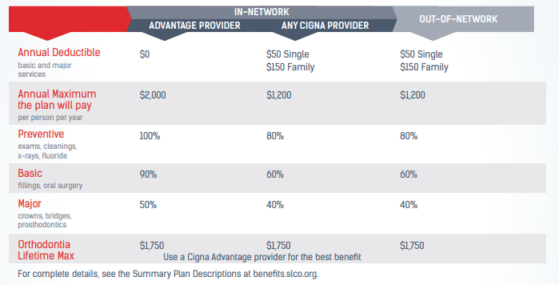
Cigna Dental DPPO

Slide 16

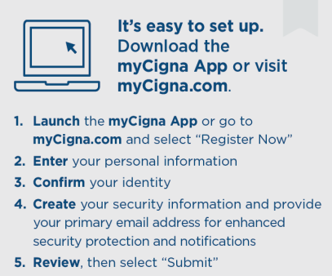
Cigna Dental DPPO
Premium – Cost per paycheck
Full Time:
Employee Only: $5.27
Employee+1: $6.74
Employee+2 or more: $10.15
Part Time:
Employee Only: $10.53
Employee+1: $13.48
Employee+2 or more: $20.31
For questions or assistance locating an in-network dentist or specialist, call Cigna at
800-244-6224
**If you do not ENROLL or WAIVE within 31 days, you will be automatically enrolled in
Cigna employee only coverage**

Slide 17

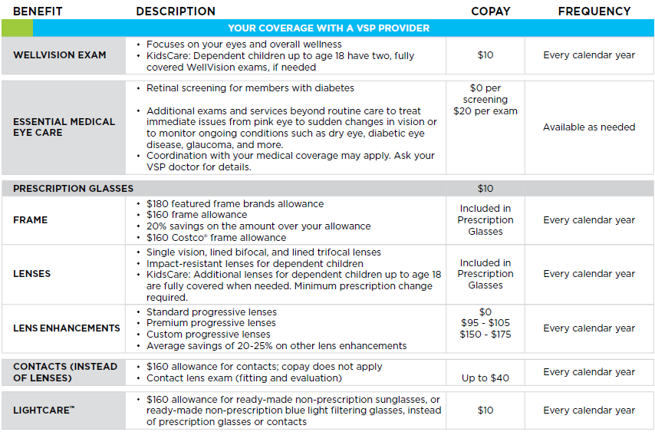
VSP Vision Care
Premiums:
Member Only - $3.58
Member + 1 - $7.43
Member + 2 or more - $11.51

Slide 18

Life Insurance
Employer Paid Life Insurance
Automatic $50,000 Term Life policy at no cost (*benefit reduces at age 70)
Employee Paid Life Insurance
Can enroll in up to $300,000 of additional coverage with no underwriting if you enroll within the first 31 days of eligibility
Coverage is available in $25,000 increments
Assign Beneficiaries in PeopleSoft
One individual or multiple, as well as Trust designation
Primary and Secondary options
Website: https://www.standard.com/
Phone: 800-628-8600

Slide 19
Life Insurance
Spouse & Dependents
Enroll in up to $50,000 spouse life without underwriting within first 31 days of eligibility
  Coverage is available in $25,000 increments
Enroll in up to $15,000 dependent life
  Applies to unmarried dependents under age 26
  Cost covers all dependents and covered at the same level
  Coverage is available in $5000 increments
  Dependent Life rate: $.096 per $1000
Website: https://www.standard.com/
Phone: 800-628-8600

Slide 20
Accidental Death & Dismemberment (AD&D)
Individual and Family plan options:
$25,000 to $250,000
Coverage is available in $25,000 increments
Family Benefits paid based on employee’s elected coverage
  Spouse only: 50% of coverage
  Dependent Child only: 20 % of coverage
  Spouse and Child(ren): 40% for spouse, 15% for each child
Provides benefits for:
Death or loss of use of limb, speech, hearing or eyesight
  Due to an accident
Employee Only Rate per $1000: $0.02
Family Rate per $1000: $0.03
Website: https://www.standard.com/
Phone: 800-628-8600

Slide 21

Short-Term Disability Insurance
  Income protection when you are unable to work due to illness or injury
  Pays 66.67% of your pre-disability weekly salary; plan max of $3000 weekly
  Begins on 15th day after onset of illness or injury
  Use accrued PTO/sick leave during waiting period and to make up pay difference
  Maximum benefit duration is 11 weeks
  Benefit eligible employees working 20+ hours/week; premium based on salary
Website: https://www.standard.com/
Phone: 800-628-8600

Slide 22

Long-term Disability Insurance
Employer paid benefit; automatic enrollment
90 Day Elimination Period
For all merit, elected and time limited benefit eligible employees working 20+ hours/week
Your responsibility to apply when you need it
Benefits Team can help
Website: https://www.standard.com/
Phone: 800-628-8600

Slide 23

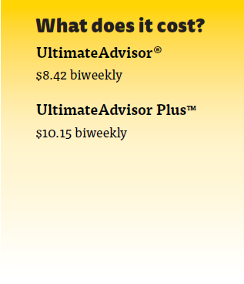
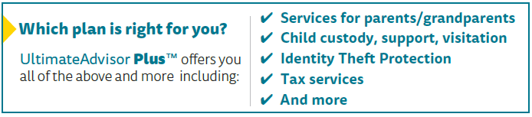

Work with a network attorney and attorney fees are 100% paid-in-full for most covered matters.
Access to more than 14,000 attorneys
Available in person or by phone
Wills and Estate Planning
Bankruptcy
Adoption
Divorce
Small Claims Court
Tax Audit and much more
Covered Dependents:
Spouse or Partner
Dependent Children up to age 26

Slide 24
HealthyMe Clinic
Healthy Lifestyles
WELLNESS
Leave
Employee Assistance Program
(EAP)

Slide 25
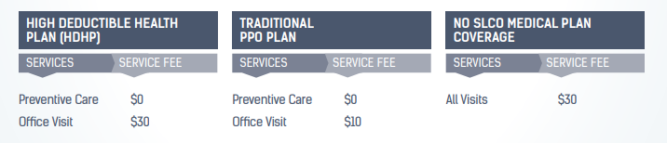

HealthyMe Clinic
You and your eligible dependents have access to exceptional, confidential, and low-cost
medical and mental health care at the HealthyMe Clinic.
**Appointment Only – No Walk-Ins**

Slide 26

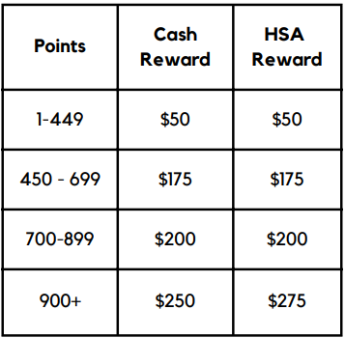
Healthy Lifestyles is an incentive-based Employee Wellness Program, promoting healthy behaviors and lifestyles, ensuring a healthier work environment and lowering overall healthcare costs
Points earned January 1st through October 31st
Website: https://slco.org/healthy-lifestyles/
Email: myhealthylifestyles@slco.org
Phone: (385) 468-4062

Slide 27

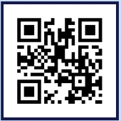

VEST EAP
Emotional Support Helpline and Resource Center
Unlimited services for you & your loved ones
CARE Center:
Anonymous & Unlimited Situational Support
Text or call 24/7 and access a live person to listen
Expert Courses available on demand, online
Wellness Coaching & Weekly Mental Health Text Tips
Download App and enter
Registration Code: SL COUNTY
Contact Us:
Toll-Free: (385) 205-6789
Website: www.blunovus.com

Slide 28
VEST EAP Support
EAP Counseling & Therapy Services:
6 Free Counseling Visits; 15 for First Responders
  Anxiety, depression, relationships, stress
  Short-term counseling with referrals for long-term
Wellness Coaching & Weekly Text Tips
Personal Support
Download App and enter
Registration Code: SL COUNTY
Contact Us:
Toll-Free: (385) 205-6789
Website: www.blunovus.com

Slide 29
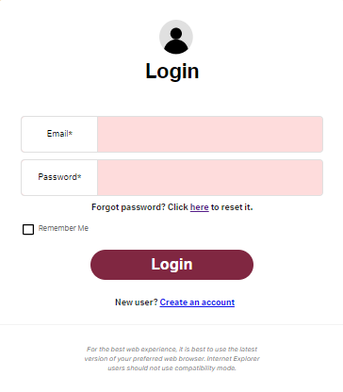
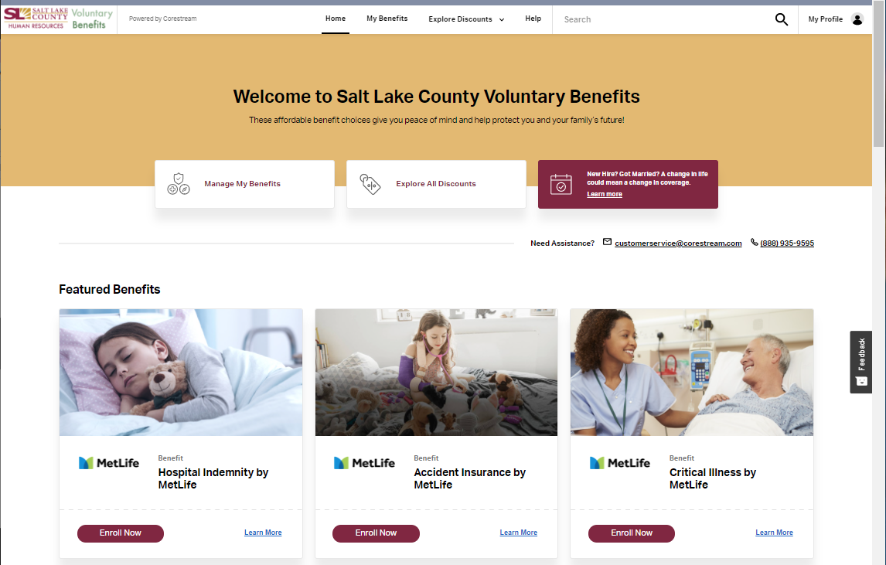
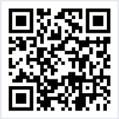
Voluntary Benefits
Scan QR code or visit http://slcountyvoluntarybenefits.com/ to enroll.

Slide 30
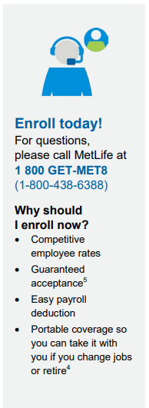


Voluntary Benefits
Additional Insurance Options
Accident Insurance
Critical Illness Insurance
Hospital Indemnity Insurance
Enroll at http://slcountyvoluntarybenefits.com/

Slide 31


Voluntary Benefits
Nationwide Pet Health Insurance
Pick your coverage – pick your price
50% or 70% reimbursement
Call 877-738-7874 for a fast, no obligation quote today!
Enroll at http://slcountyvoluntarybenefits.com/

Slide 32


Voluntary Benefits
Student Loan Refinancing & Loan Repayment
Student Loan Financial Education via consultations, webinars
Public Service Loan Forgiveness Membership
Contact Us:
Toll-Free: 844-GRADFIN
Website: www.GradFin.com
Enroll at http://slcountyvoluntarybenefits.com/

Slide 33

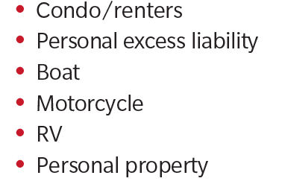
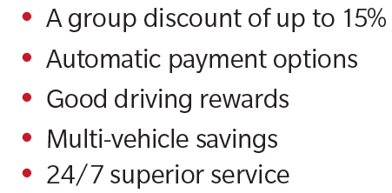
Voluntary Benefits
Farmers Home
& Auto Insurance
Call 844-300-7021
Mention discount code: A20
Enroll at http://slcountyvoluntarybenefits.com/

Slide 34
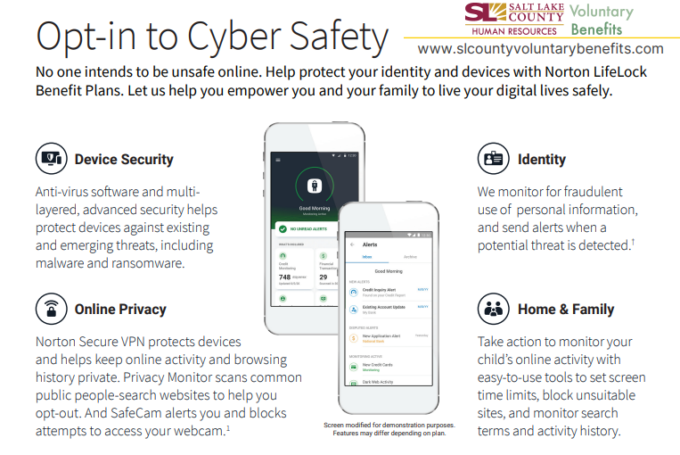


Voluntary Benefits
Norton LifeLock Benefit Solutions
Enroll at http://slcountyvoluntarybenefits.com/

Slide 35

Tuition Reimbursement
Salt Lake County financially supports the educational pursuits of its employees through the Tuition Reimbursement Program.
Managed by Cynthia Carrington:
(385) 468-0576 or CCarrington@saltlakecounty.gov
Eligibility determined in HR Policy 6-300
Website: https://slco.org/human-resources/learning--development/tuition-reimbursement/

Slide 36

Leave Policy
HR Policy 4-200 Leave Practices
Vacation
Sick
Holiday
Personal Preference Day
Jury and Witness
Military
Funeral
Miscarriage and Still Birth Bereavement
Parental
Human Resource Policies, Section 4: Benefits
https://slco.org/human-resources/policies/human-resources-policies/

Slide 37
Steps to Enroll
Required:
Log in to PeopleSoft at: https://pshcm.slcounty.org/
Enroll or waive elections for:
Medical
Dental
Vision
Health Savings Account (HSA)
Flex Spending Accounts (FSA)
  Medical, Limited, Daycare
Life Insurance
  Supplemental, Spouse, Dependent Life
Accidental Death & Dismemberment (AD&D)
Short-Term Disability
ARAG Legal
Complete within 31 days of hire
**Designate beneficiaries on Life Insurance policies**

Slide 38
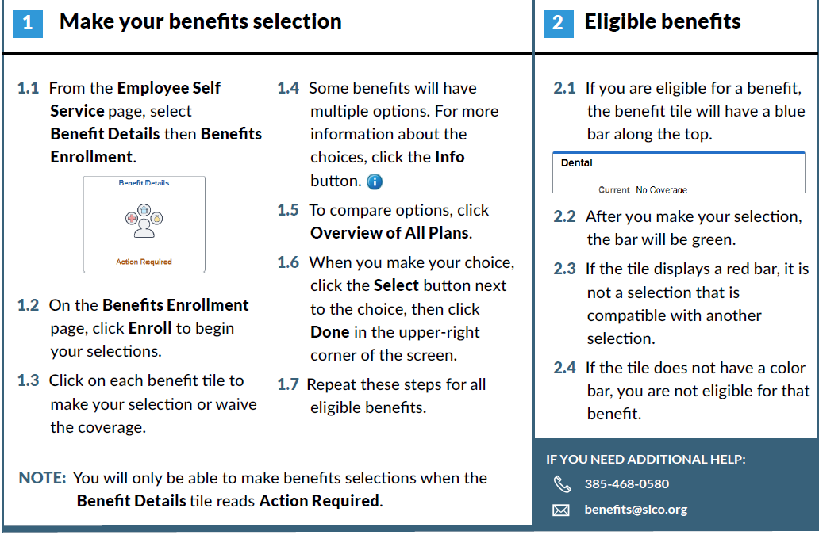
PeopleSoft Fluid Enrollment

Slide 39

Retirement with URS
Certification letter via county email with account number
  Account number begins with ‘W’
Login to http://www.urs.org/
Assign beneficiaries
Elect optional savings plans
**Employees in Tier 2 have ONE year within their hire date to select a retirement plan**

Slide 40
WELLNESS
On-Site Clinic
Healthy Lifestyles
EAP
Leave
INCOME PROTECTION
Short Term Disability
Long Term Disability
Life Insurance
Hospital Indemnity
Accident/Illness
HEALTH
Medical & Pharmacy
Dental
Vision
SAVINGS PLANS
Retirement
URS Plan Options
Health Savings Account
Flexible Spending Accounts
– Health, Daycare & Limited
DISCOUNTS
& PERKS
Voluntary Benefits
On-site Daycare

Slide 41
Welcome to Salt Lake County!
Benefits Orientation 2024
Benefits team contacts:
phone: (385) 468-0580
email: benefits@saltlakecounty.gov
website: https://slco.org/human-resources/benefits/
**Remember – You have 31 days from your date of hire
to enroll in or waive your benefits**

Slide 42
- BREAK -

